Slide 1




Space rocks in the desert
Watching the sky over southern Arizona for meteorite-dropping fireballs
Muneeb Ahmed

Slide 2
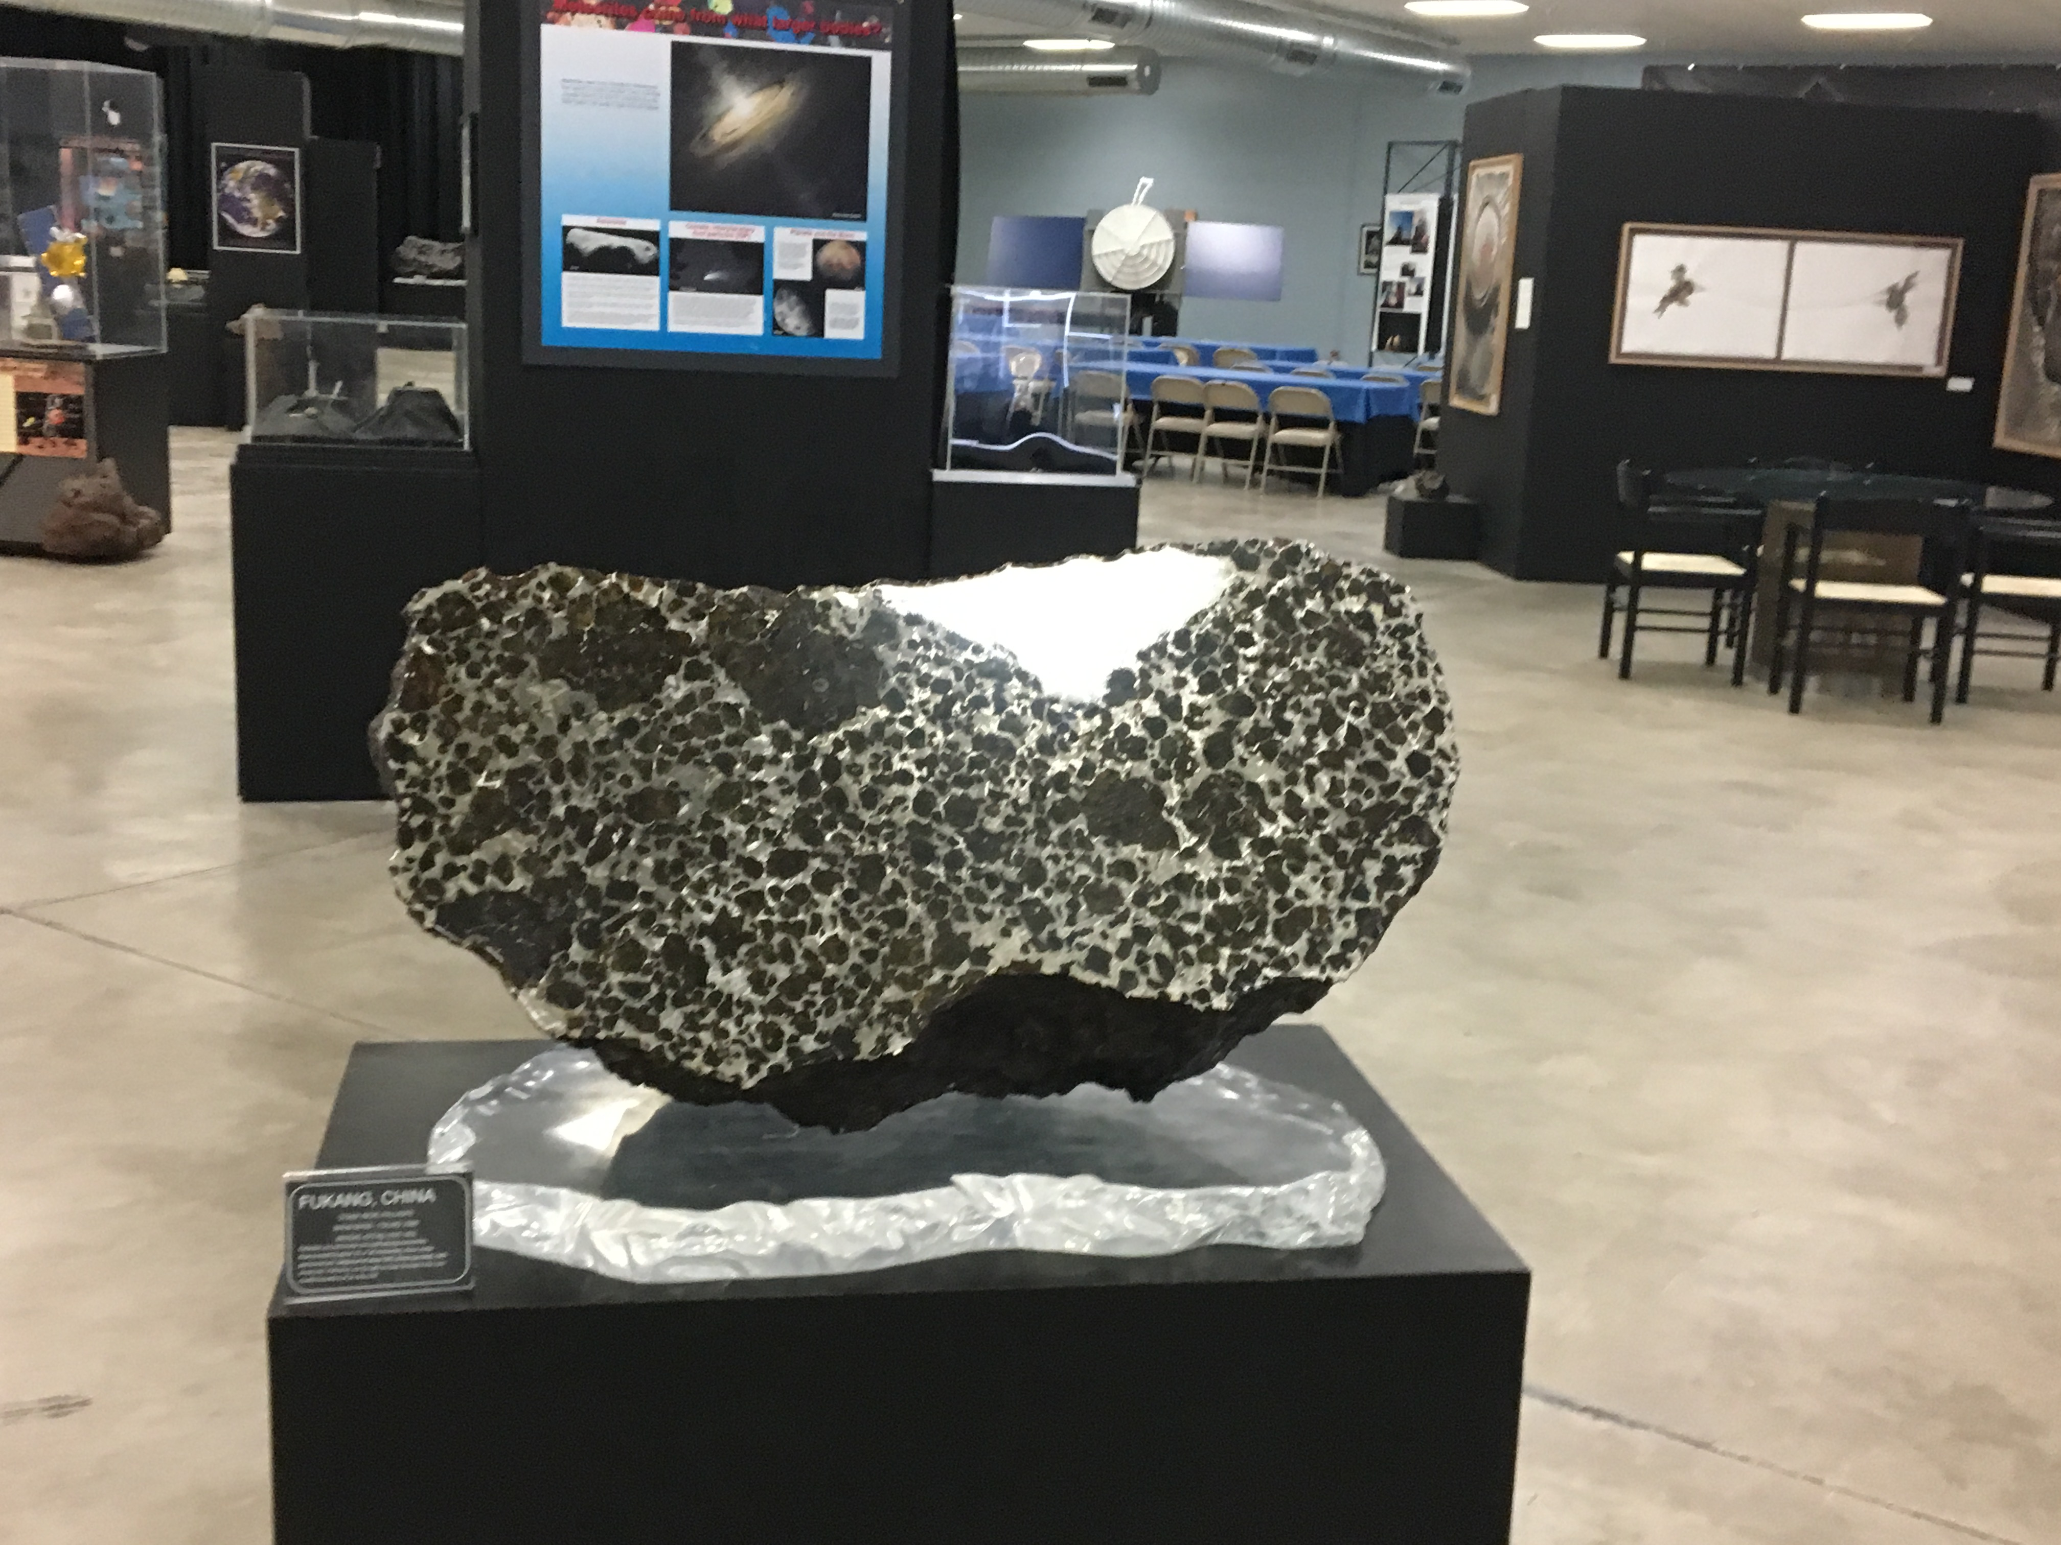
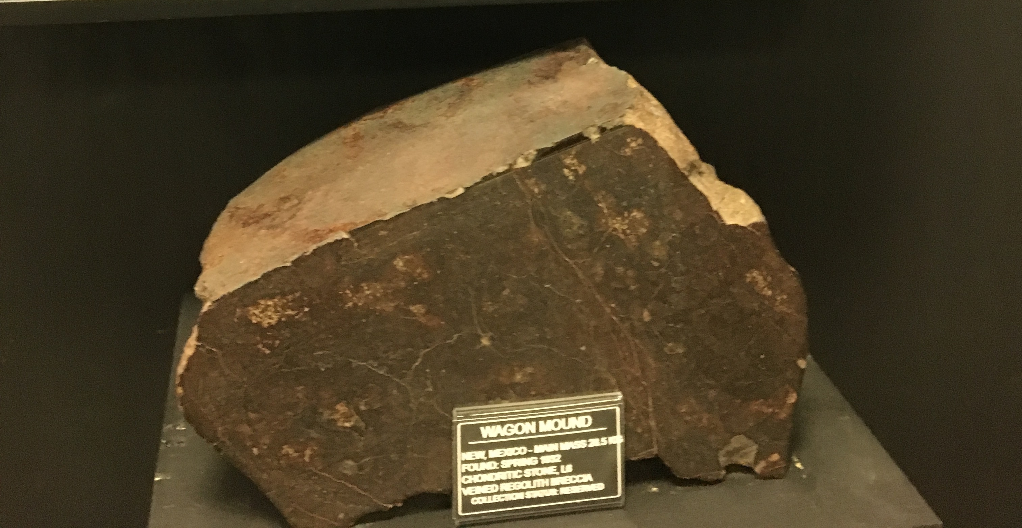
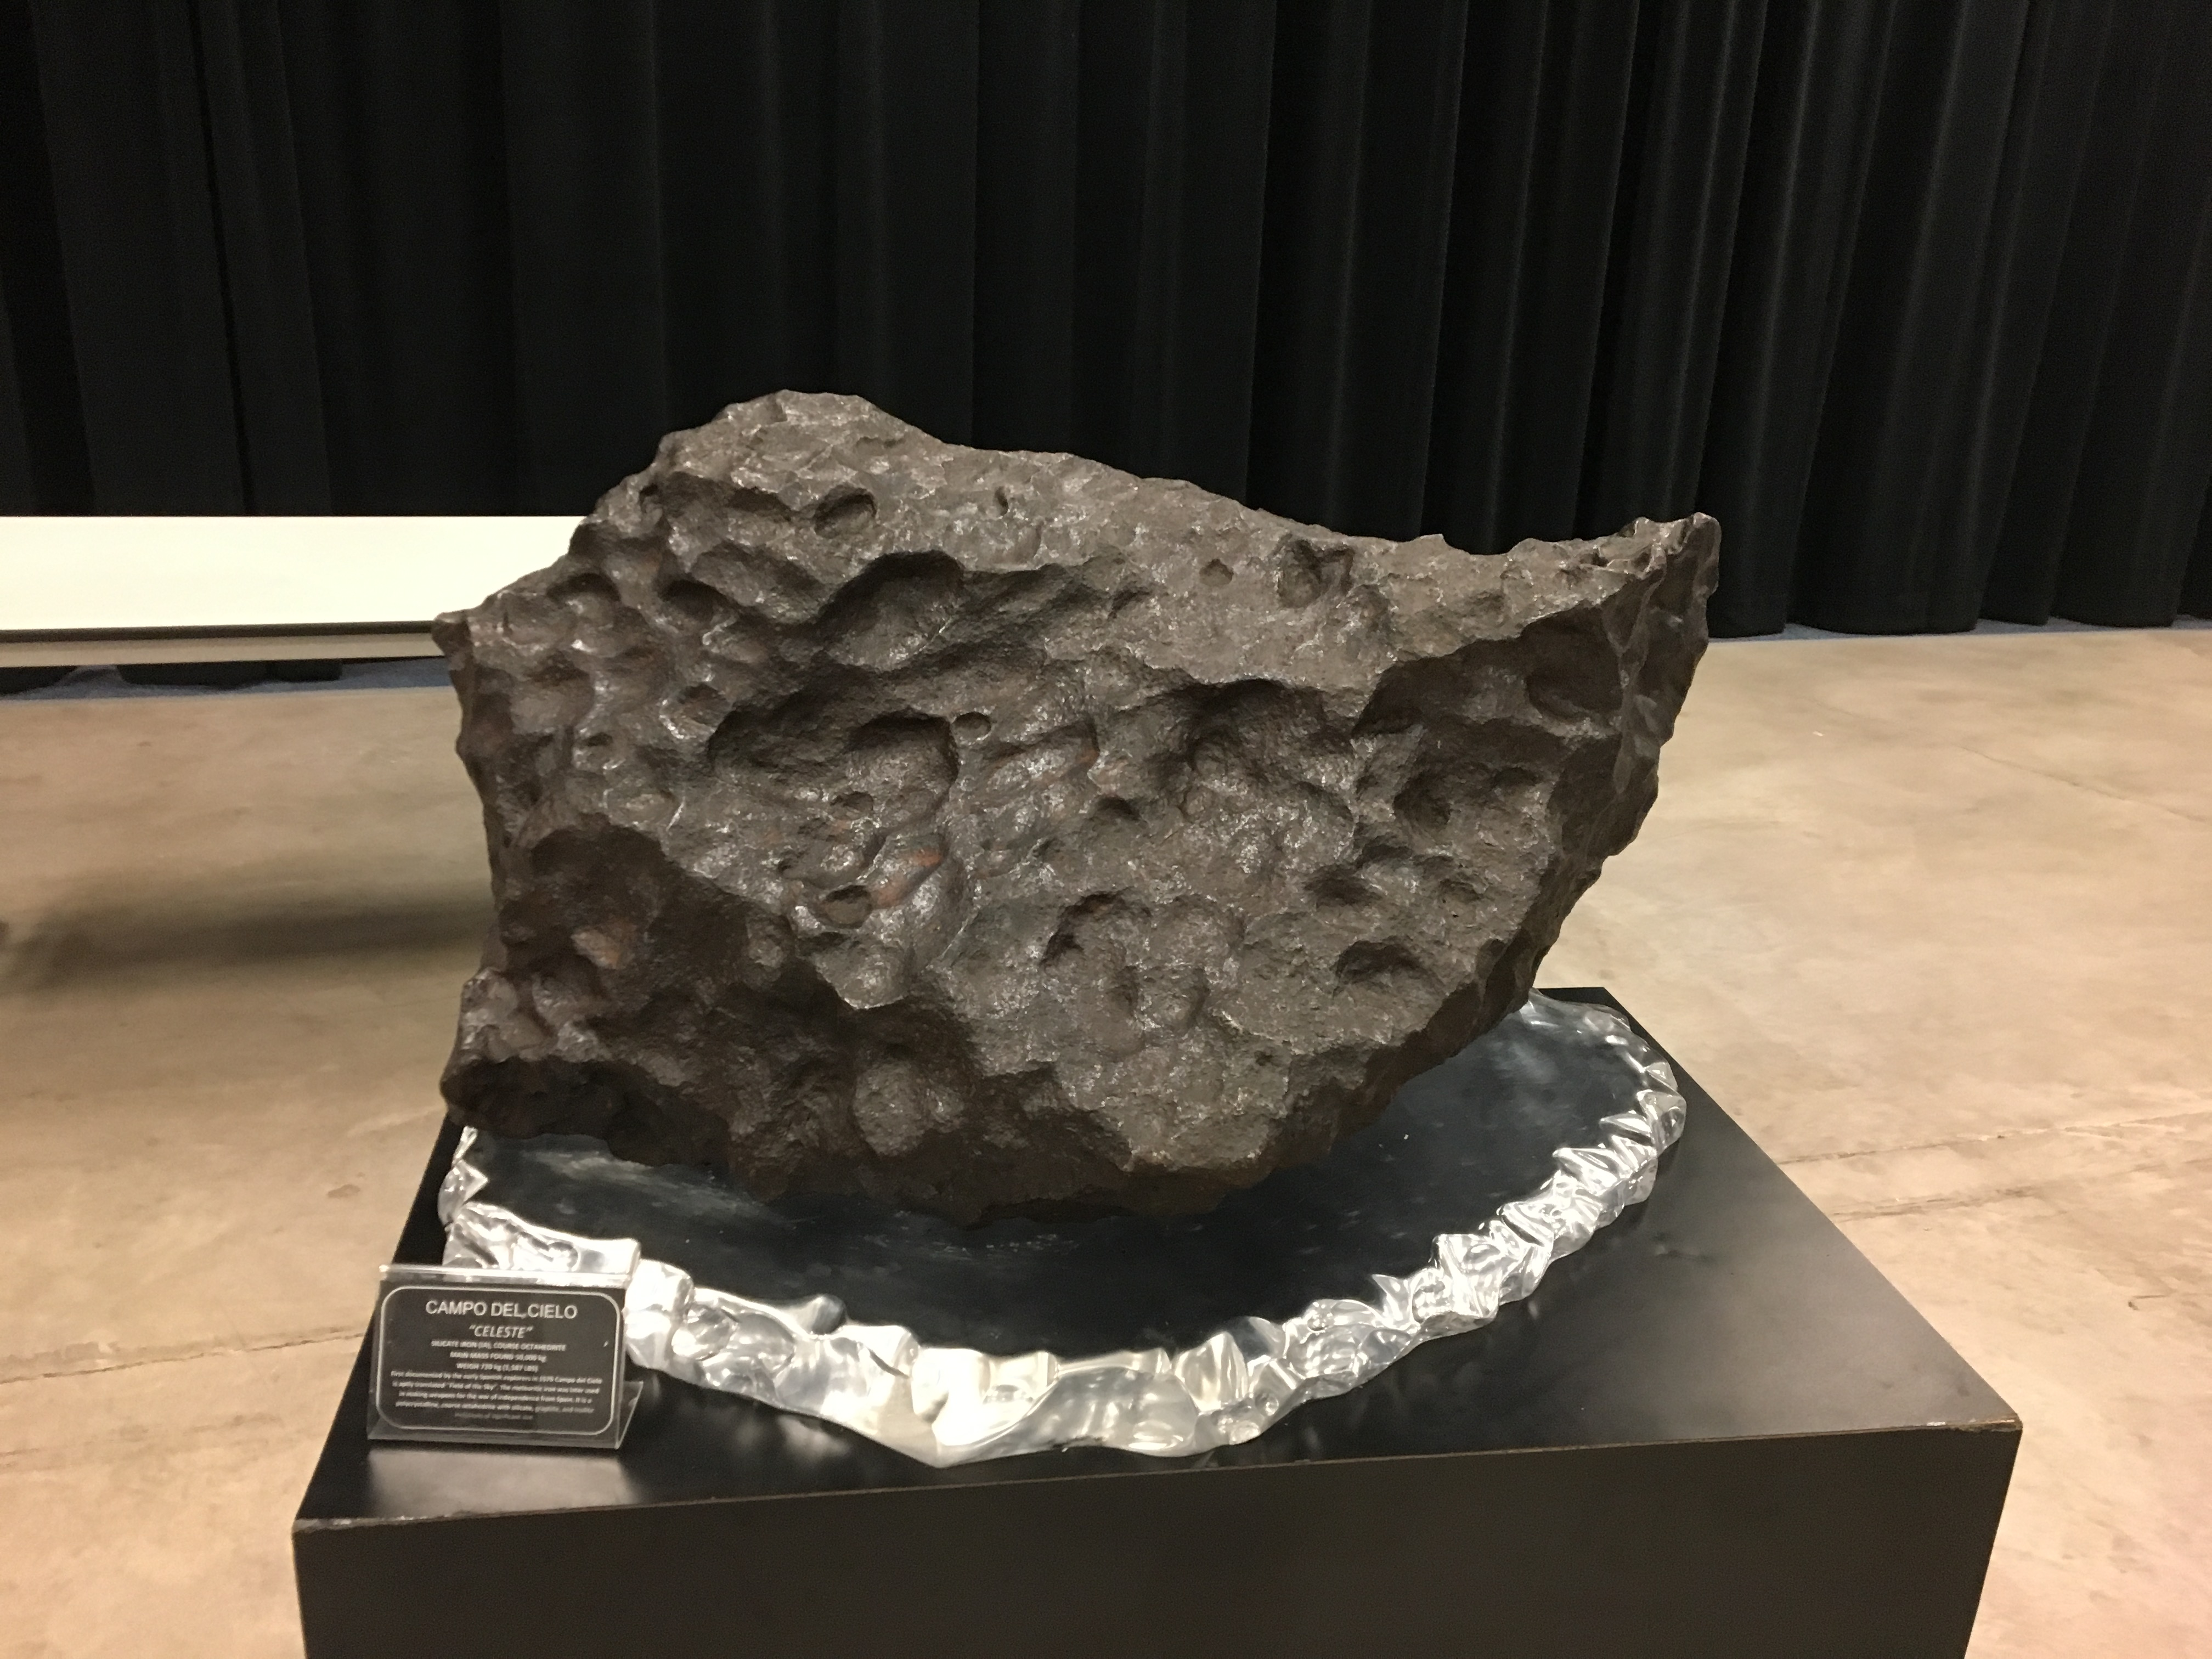
Motivation: Meteorites
Chondrites vs. Achondrites:
What can they tell us?
Source: Michael J. Drake Building, University of Arizona
Notes:
Meteorites, pallasite and chondrites.

Slide 3
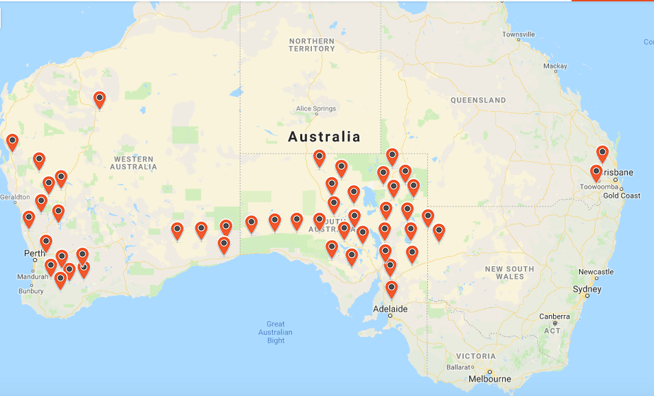
Original Project: Australia
Region | Institution | Delivered | Deployed | Need Servicing
🇦🇺 DFN | Curtin University | 52 | 52 | 13
🇦🇺 NSW | Macquarie | 2 | 0 | 0
🇦🇺 Victoria | Monash | 2 | 0 | 0
🇦🇺 ACT | ANU | 2 | 0 | 0
🇦🇺 Queensland | USQ | 3 | 2 | 1
🇬🇧 UK | Imperial College | 4 | 3 | 1
🇸🇦 Saudi Arabia | NCA | 2 | 0 | 0
🇲🇦 Morocco | Université Hassan II de Casablanca | 4 | 3 | 2
🇨🇦 Western Canada | University of Western Ontario | 3 | 1 | 0
🇨🇦 Eastern Canada | Alberta | 3 | 2 | 1
🇺🇸 AZ, USA | U of A | 4 | 0 | 0
🇺🇸 CA, USA | SETI Institute | 5 | 4 | 1
🇺🇸 TX, USA | Lunar and Planetary Institue | 3 | 1 | 0
🇺🇸 AL, USA | NASA Meteoroid Environment | 3 | 1 | 0
Total |  | 92 | 65 | 26
Source: Desert Fireball Network
Notes:
Recovered 4

Slide 4
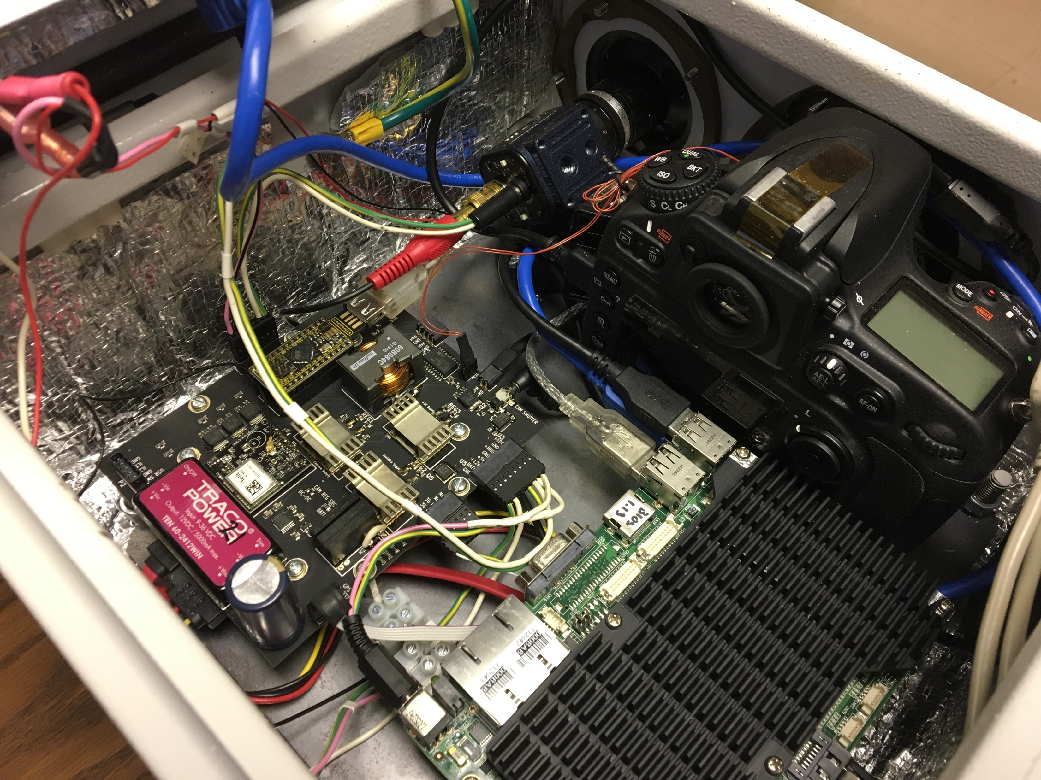
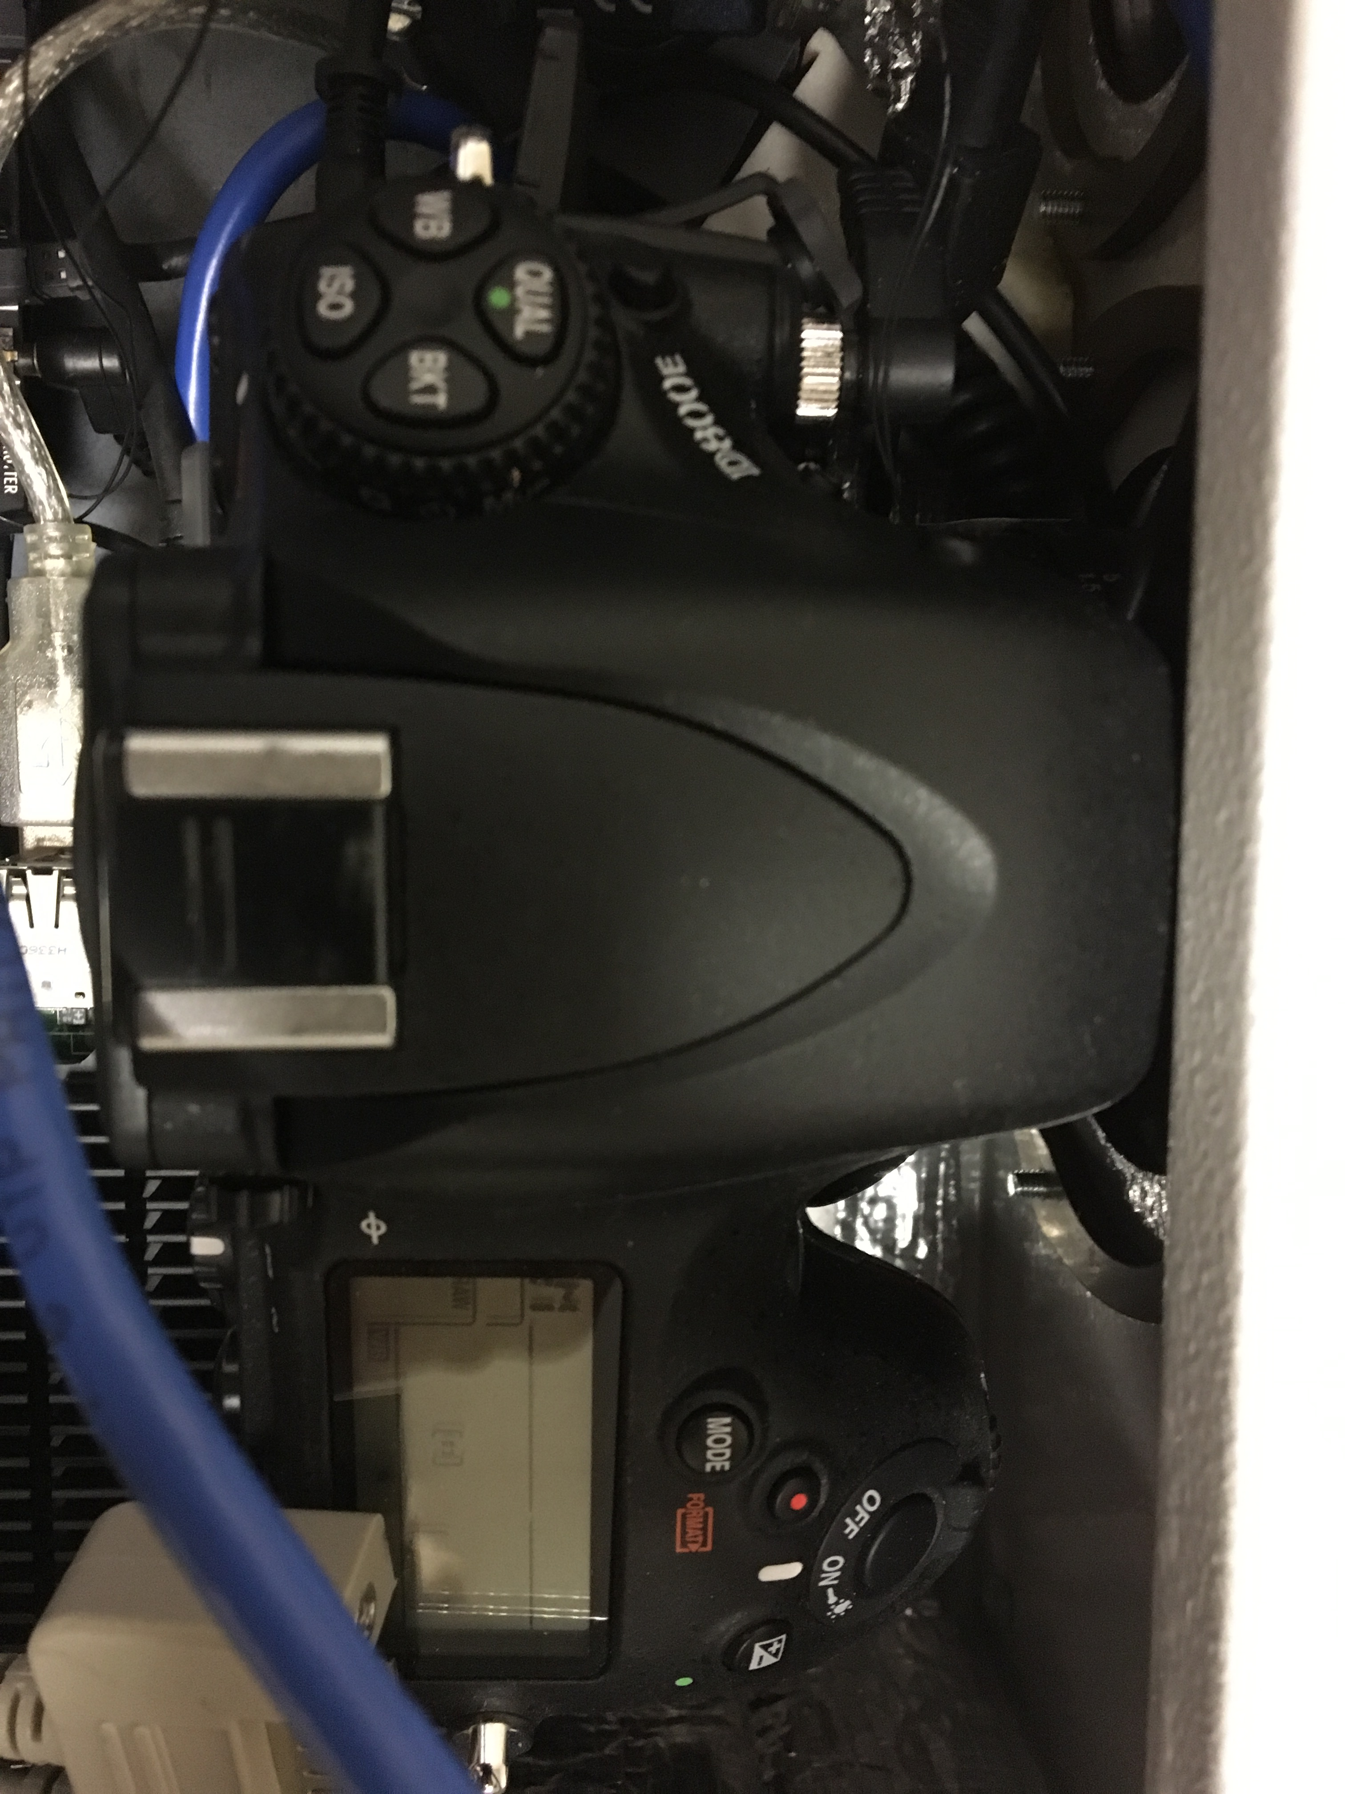
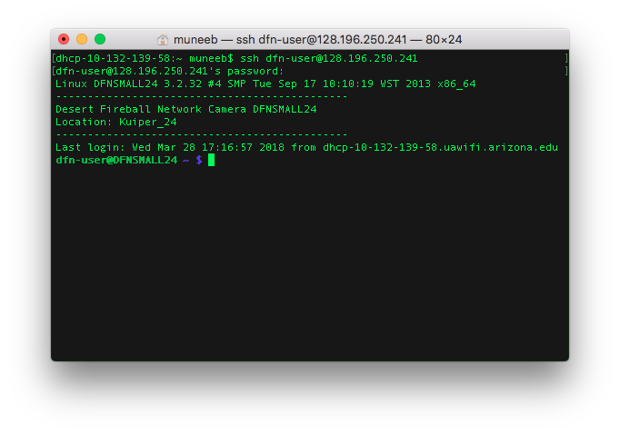
Servicing the Cameras
Microcontrollers, lenses, software, and more

Slide 5
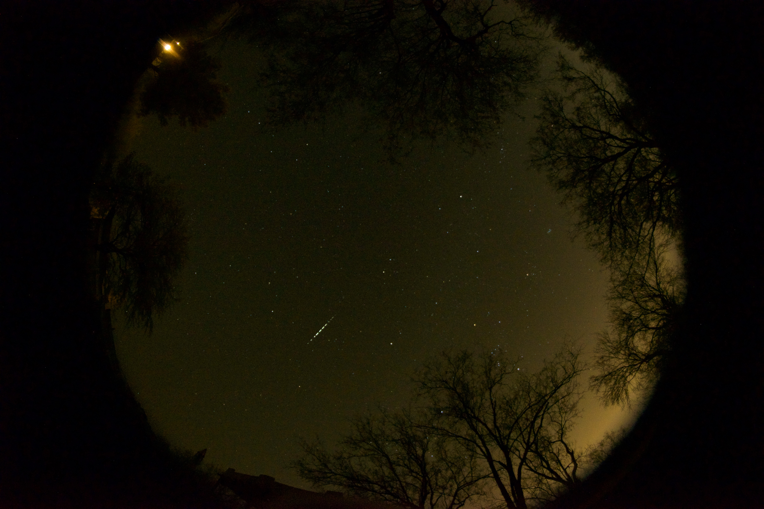
Capturing Fireballs
Prime Target:
Meteor Showers
Perseids
Leonids
Geminids
Geminids, December 14, 2017
Notes:
Dec 14, peak of the Geminids

Slide 6
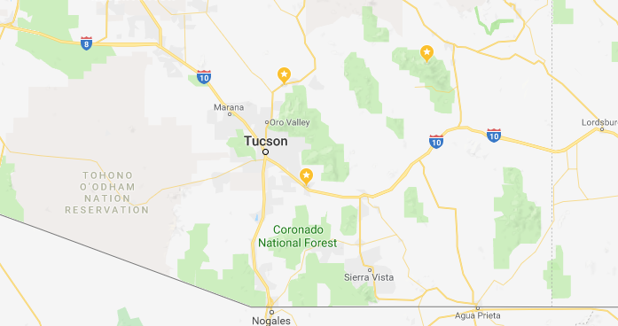
Prospective Locations
Biosphere 2
Vatican Observatory
Vail
Ideal:
An equilateral triangle 100 km on each side
Notes:
90 k, 65k, 110k

Slide 7
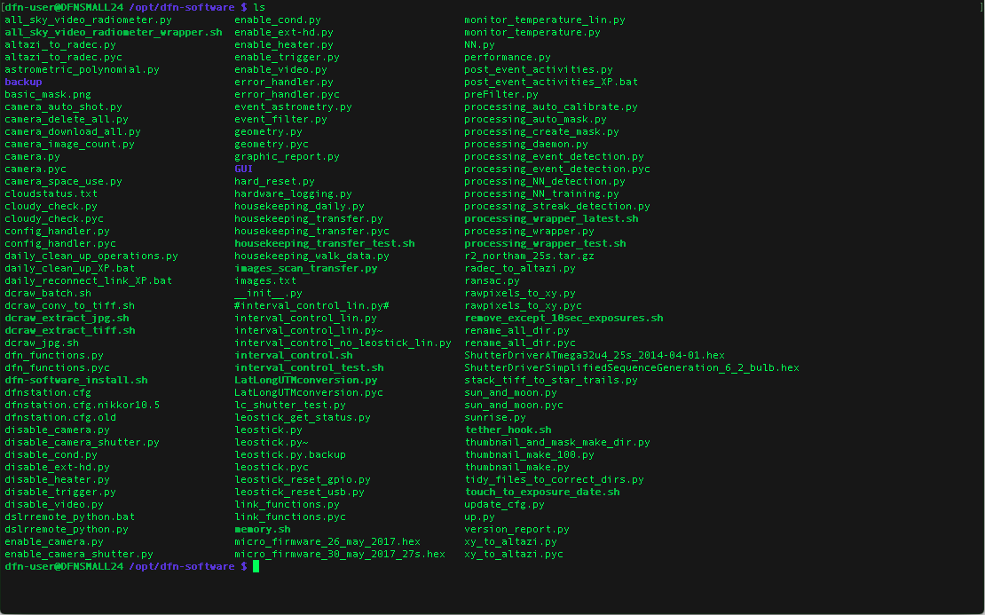
Data Processing and Outcomes
Each of hundreds of raw images is 40+ MB
Local processing on camera detects meaningful events
Logs and event data are sent back to Australia
Specific images can be downloaded remotely
Notes:
90 k, 65k, 110k

Slide 8
Acknowledgements
Dr. Phil Bland
Dr. Martin Towner
Martin Cupak
Ben Hartig
Dr. Tim Swindle
Carl Hergenrother

